Slide 1

Report and celebrate service

Slide 2
REPORTING SERVICE
(Report the new way)
Notes:
We have a simplified way to report
**Now we can compare by walking through the new way

Slide 3
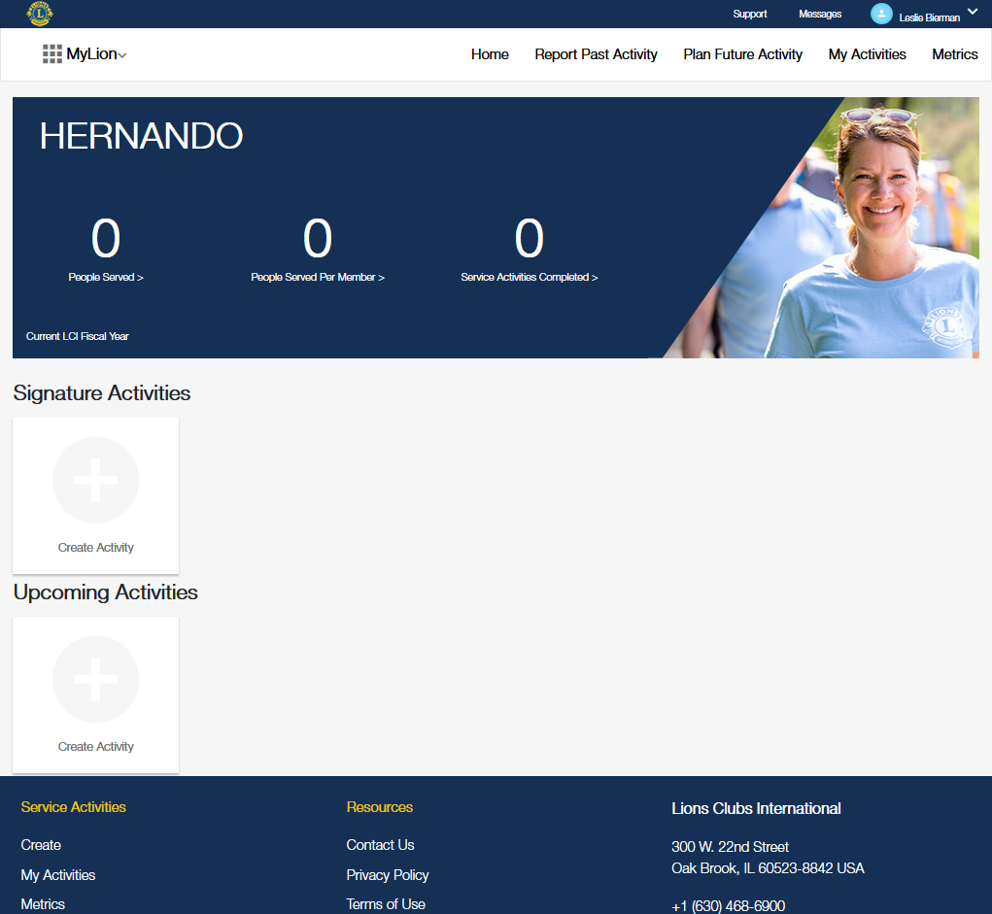
1.
Notes:
1. Select the “Report Past Activity” option at the top of the page

Slide 4
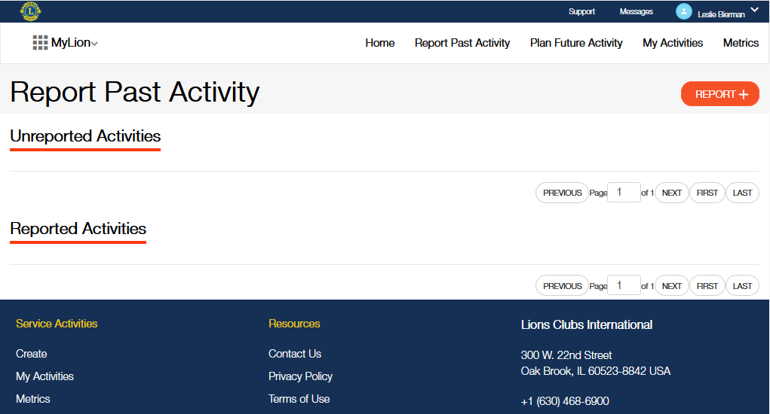
2.
Notes:
2. Select the Report + button
**Must be a reporting officer to see this button

Slide 5
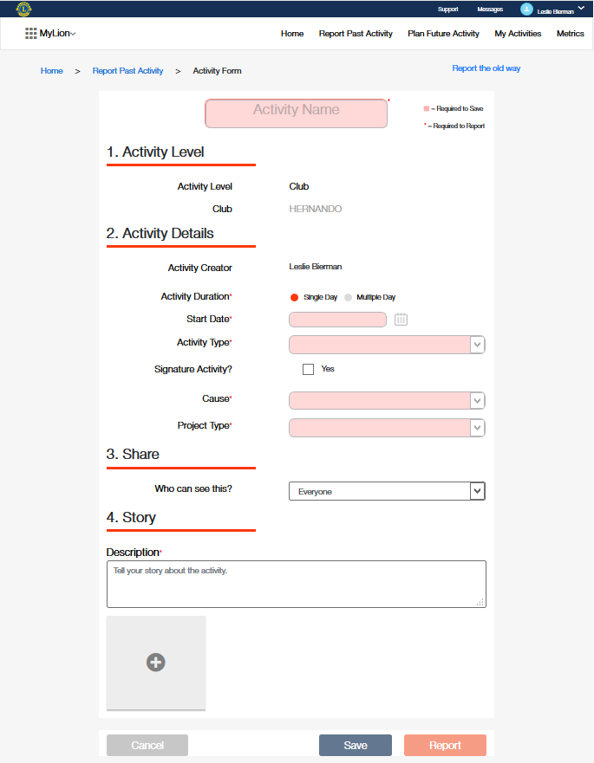
3A.
3B.
Notes:
3. (A) Complete the sections of the form
-- Fields with red boxes are required to save your work
-- Fields with red asterisks are required to report the activity to LCI
(B) Select Report

Slide 6
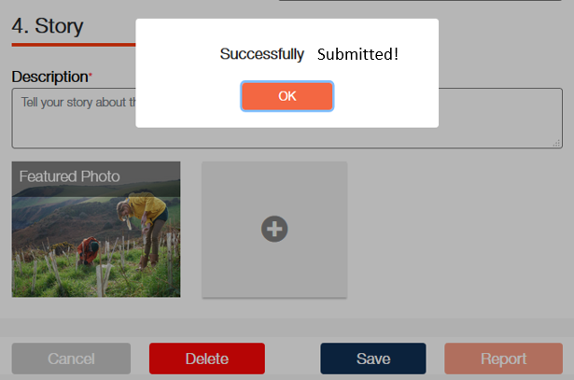
4.
Notes:
4. Select Ok

Slide 7
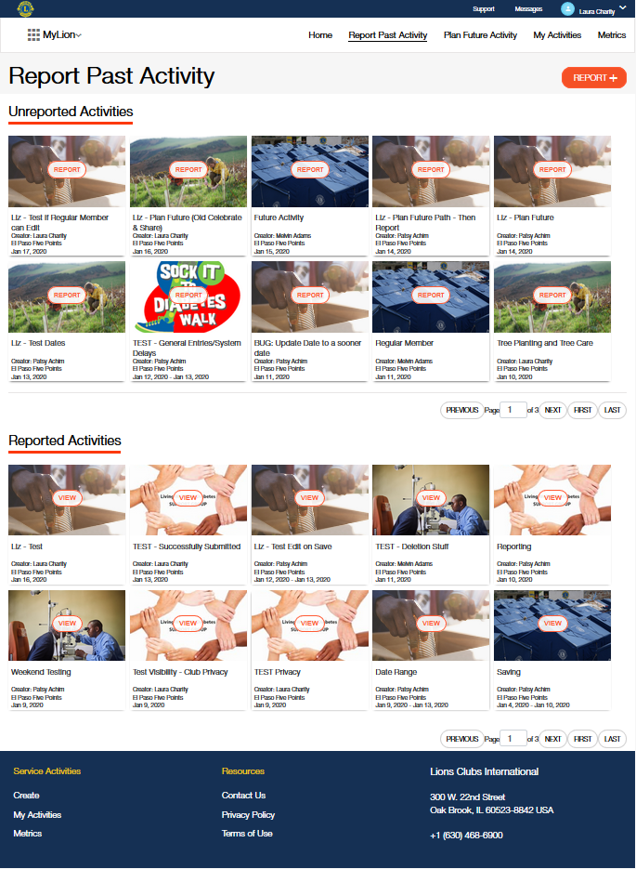
5C.
5A.
5B.
Notes:
5. You will land on the Report Past Activity page
(A) If you have additional activities that you want to report, select the Report button and continue with your next activity.
(B) You can select an activity from the list of Unreported Activities if you are ready to report for one the was saved earlier.
(C) To navigate away from this page, select the MyLion application switcher.

Slide 8
Thank you!
© 2019 Lions Clubs International

